Slide 1
8. Everything you wanted to know about random variables but were afraid to ask

Slide 2
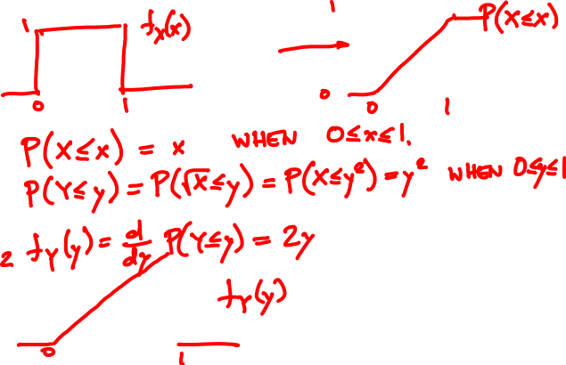
X is Uniform(0, 1). What is the PDF of Y = √X?

Slide 3
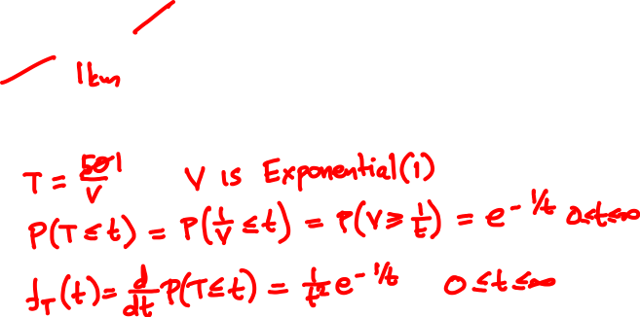
🚙
V = 50 Exponential(1) km/h
50km
0km
What is the PDF of the travel time?

Slide 4
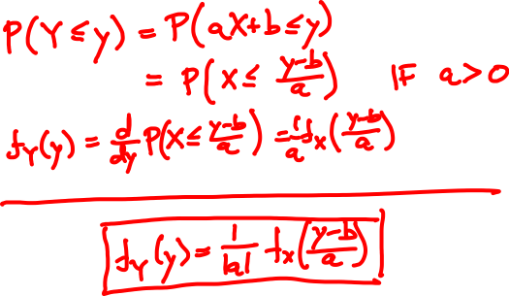
Shifting and scaling
Y = aX + b

Slide 5
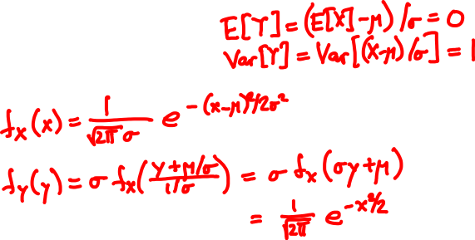
Normalization
X is Normal(μ, σ)
Y = (X – μ)/σ

Slide 6
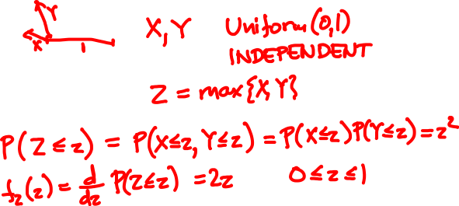
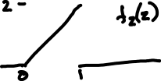
What is the PDF of the loser?

Slide 7
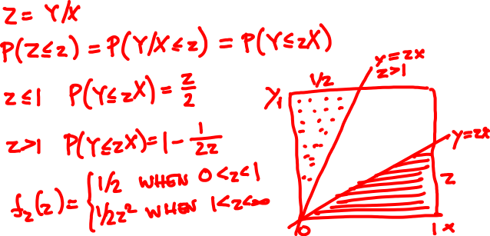
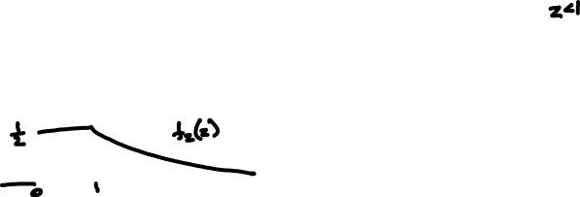
X, Y are independent Uniform(0, 1).
What is the PDF of Y/X?

Slide 8
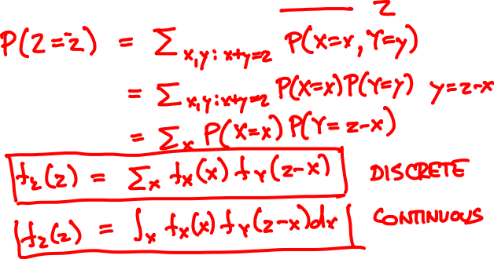
Convolution
X, Y are independent.
What is the PMF/PDF of X + Y?

Slide 9
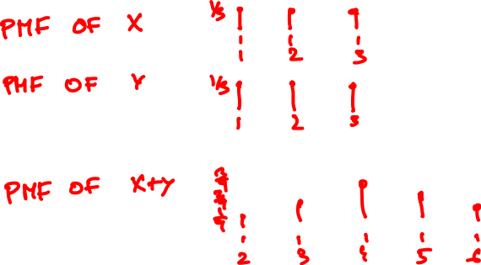
X, Y are face values of 3-sided dice.
What is the PMF of X + Y?

Slide 10
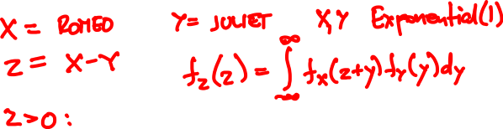

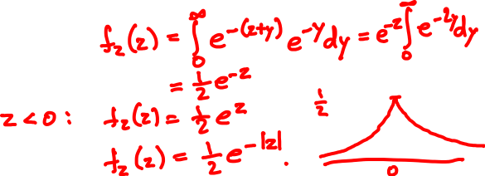
Romeo and Juliet arrive in Shatin at independent Exponential(1) hours past noon.
How long is the wait?

Slide 11
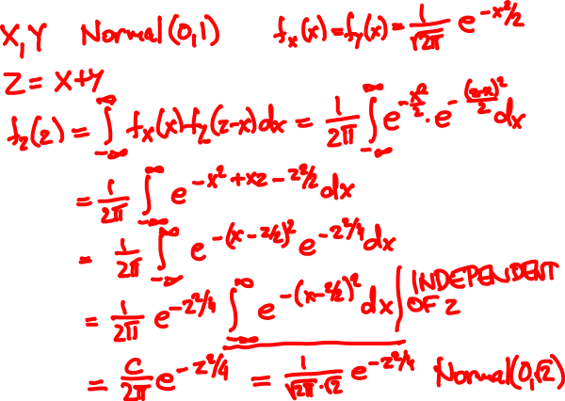
Sum of Independent Normals

Slide 12
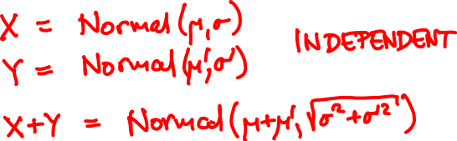
Sum of Independent Normals

Slide 13
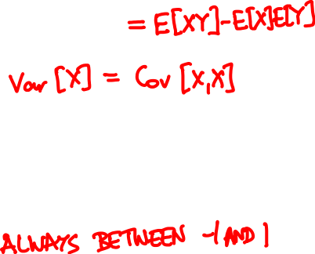
Measuring dependence
Cov[X, Y] = E[(X – E[X])(Y – E[Y])]
Cov[X, Y]
Corr[X, Y] =
√Var[X] Var[Y]

Slide 14
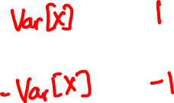
Measuring dependence
Cov
Corr
X, Y ind.
Y = X
Y = -X
Warning: Zero-covariance is not independence!

Slide 15


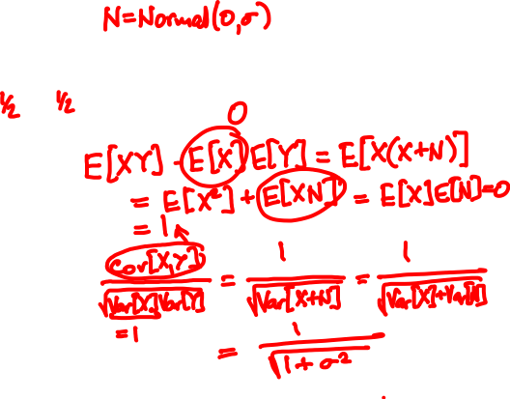
X = 1 or -1
Y = X + N
Cov[X, Y] =
Corr[X, Y] =

Slide 16

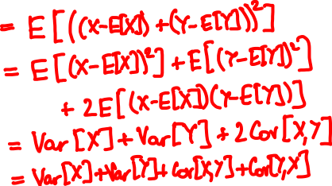
Variance of a sum
Var[X + Y] = Var[X] + Var[Y] if independent

Slide 17
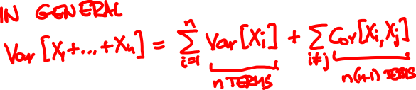
Variance of a sum
Var[X₁ + … + X_{n}] = Var[X₁] + … + Var[X_{n}]
if every pair X_{i}, X_{j} is independent.

Slide 18
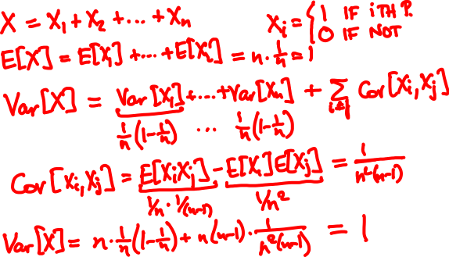
n people throw their hats in a box and pick one out at random. What is the variance of the number of people who get their own?

Slide 19
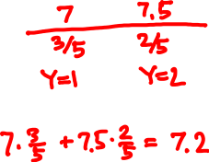
🙋‍♂️
🤡
3
🙇‍♂️
10
9
🙍🏼‍♀️
8
💁‍♂️
6
1
2
X = score
E[X |Y]:
Y = section
E[X] =

Slide 20
Estimation
^
X = E[X |Y] is an estimator for X given Y
^
E[X] = E[X] = E[E[X | Y]]
Total expectation theorem
~
^
X = X – X is the error

Slide 21


🙋‍♂️
🤡
3
🙇‍♂️
10
9
🙍🏼‍♀️
8
💁‍♂️
6
1
2
🙋‍♂️ 🙍🏼‍♀️ 🤡 🙇‍♂️ 💁‍♂️
^
X = E[X |Y]:
~
^
X = X – X:
~
E[X |Y]:
^
~
E[XX |Y]:

Slide 22

Estimation
^
X = E[X |Y] is an estimator for X given Y
~
^
X = X – X is the error
~
E[X |Y] =
^
~
E[XX |Y] =
^
~
Cov[X, X] =

Slide 23
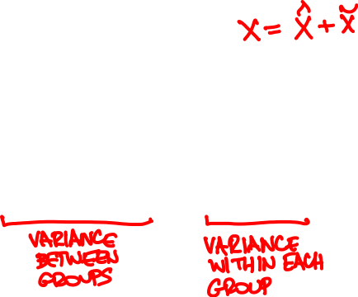
Conditional variance
~
Var[X |Y] = E[X² | Y]
Total variance theorem:
^
~
Var[X]
= Var[X] + Var[X]
= Var[E[X | Y]] + E[Var[X |Y]]

Slide 24
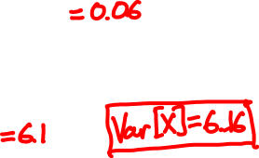
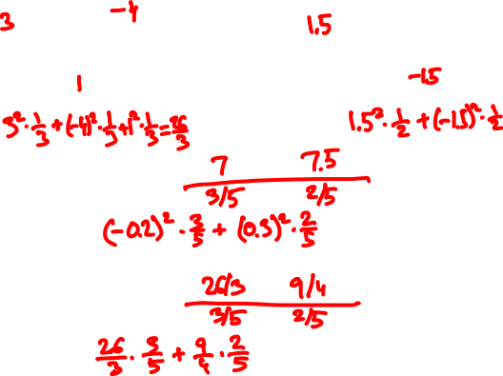



🙋‍♂️
🤡
3
🙇‍♂️
10
9
🙍🏼‍♀️
8
💁‍♂️
6
1
2
^
X = E[X |Y]:
Var E[X |Y] =
Var[X | Y]:
E Var[X |Y] =

Slide 25
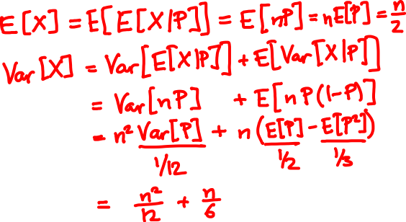
P is Uniform(0, 1), X is Binomial(n, P)
What is Var[X]?

Slide 26
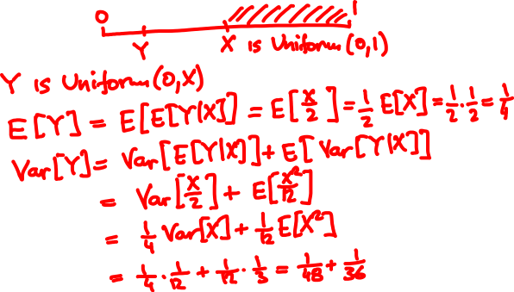
Break a stick of length 1 at a random point. Keep the left part and repeat. What is the E and Var of the length?

